Slide 1
Operation Analytics and Investigating Metric Spike

Slide 2
Description
Operational Analytics is a crucial process that involves analyzing a company's end-to-end operations. This analysis helps identify areas for improvement within the company. As a Data Analyst, you'll work closely with various teams, such as operations, support, and marketing, helping them derive valuable insights from the data they collect. One of the key aspects of Operational Analytics is investigating metric spikes. This involves understanding and explaining sudden changes in key metrics, such as a dip in daily user engagement or a drop in sales. As a Data Analyst, you'll need to answer these questions daily, making it crucial to understand how to investigate these metric spikes. In this project, you'll take on the role of a Lead Data Analyst at a company like Microsoft. You'll be provided with various datasets and tables, and your task will be to derive insights from this data to answer questions posed by different departments within the company. Your goal is to use your advanced SQL skills to analyze the data and provide valuable insights that can help improve the company's operations and understand sudden changes in key metrics.

Slide 3
Approach
• Understanding the data • Getting familiar with the data values and attributes • For doing analysis, I have been given datasets for each case study. These tables have data related to different metrics. I will be running SQL queries on these tables to find the required information.
TECH STACK Used
Microsoft Excel
MySQL 8.0 Workbench

Slide 4
Case Study 1: Job Data Analysis
I will be working with a table named job_data with the following columns:
job_id : Unique identifier of jobs
actor_id : Unique identifier of actor
Event : The type of event (decision/skip/transfer).
Language : The Language of the content
time_spent : Time spent to review the job in seconds.
Org : The Organization of the actor
Ds : The date in the format yyyy/mm/dd (stored as text).

Slide 5
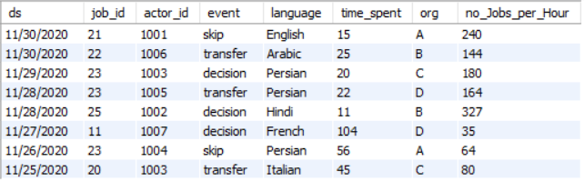
Jobs Reviewed Over Time
Calculate the number of jobs reviewed per hour for each day in November 2020
SQL Query :- select *, round(3600/ time_spent) no_Jobs_per_Hour from job_data;

Slide 6
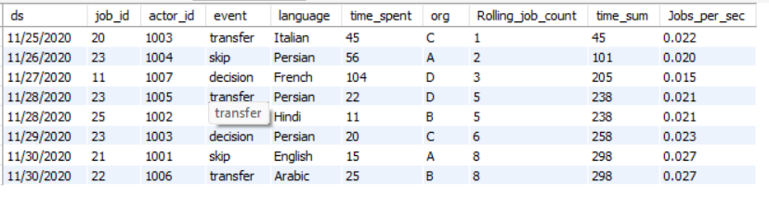
Throughput Analysis
Calculate the 7-day rolling average of throughput.
SQL Query :- select *, count(job_id) over(order by ds) Rolling_job_count, sum(time_spent) over(order by ds) time_sum, round (count(job_id) over(order by ds) /sum(time_spent) over(order by ds) ,3) Jobs_per_sec from job_data;

Slide 7
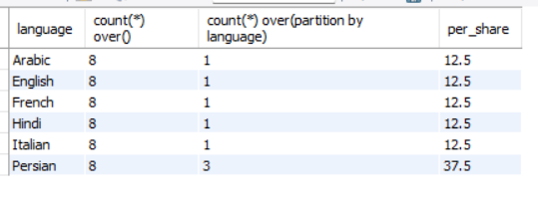
Language Share Analysis
Calculate the percentage share of each language over the last 30 days.
SQL Query :- select round(count(*)*100/c,1) percent_share, language from job_data cross join (select count(*) c from job_data) a group by language,c ;
select distinct language, count(*) over(),count(*) over(partition by language),round(count(*) over(partition by language) *100/count(*) over(),1) per_share from job_data;

Slide 8


DuplicatE Rows Detection
Display duplicate rows from the job_data table.
SQL Query:- select ds, count(ds) from job_data group by ds having count(ds) > 1;
select * from (select *,(row_number() over(partition by ds)) b from job_data) a where b > 1 ;;

Slide 9
Case Study 2: Investigating Metric Spike
I will be working with three tables:
users: Contains one row per user, with descriptive information about that user’s account.
events: Contains one row per event, where an event is an action that a user has taken (e.g., login, messaging, search).
email_events: Contains events specific to the sending of emails.

Slide 10
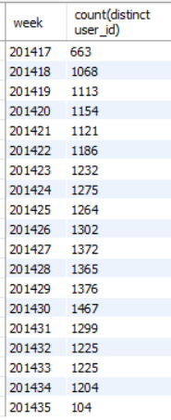
Weekly User Engagement
Calculate the weekly user engagement.
SQL Query :- select YEARWEEK(occurred_at) week,count(distinct user_id) from events where event_type = 'engagement' group by week ;

Slide 11
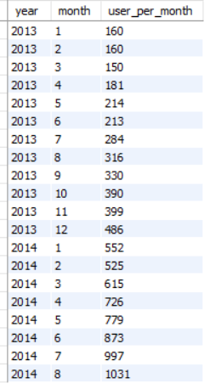
User Growth Analysis
Calculate the user growth for the product.
SQL Query :- select year(created_at) year, month(created_at) month,count(*) user_per_month from users group by year,month;

Slide 12
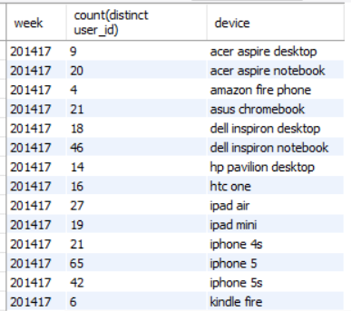
Weekly Engagement Per Device
calculate the weekly engagement per device.
SQL Query :- select yearweek(occurred_at) week, count(distinct user_id), device from events where event_type ='engagement' group by week,device;

Slide 13
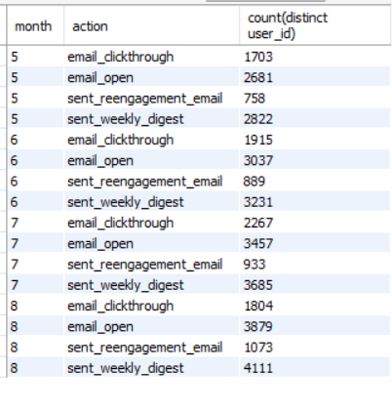
Email Engagement Analysis
Calculate the email engagement metrics.
SQL Query :- select month(occurred_at) month,action,count(distinct user_id) from emailevents group by month,action;

